Slide 1
F.CS311 Creation of Software Development
Student Name : B. Turmandakh
Student Code : B160910831

Slide 2
CLOUD COMPUTING
Cloud computing is a technology that share computing resources (such as servers, storage, database ) over the internet. Instead of buying expensive physical hardwares, users can access that resources using internet.
IaaS (Infrastructure as a service) : Provides computing resources. It includes virtual machine, storage and networking.
Paas (Platform as a service) : User doesn’t need to deal with complexities of infrastructure.
Saas (Software as a service) : User access the pre build softwares through a web browser. Saleforce, Google sheet and Office 365 etc.

Slide 3

CLOUD FOUNDRY
Cloud Foundry is an open-source platform-as-a-service (PaaS) that simplifies application deployment and management. It supports multiple cloud providers, automates tasks for developers, ensures application portability, and includes features like scaling, load balancing, and a service marketplace for easy integration of essential services. It abstracts away infrastructure complexities, allowing developers to focus on writing code and accelerating the application lifecycle

Slide 4
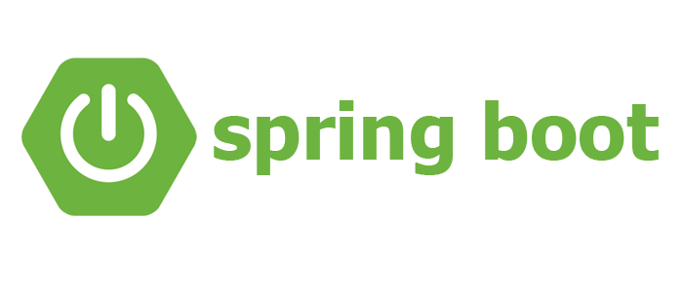
Spring Boot
Spring Boot is an open-source Java web development framework that simplifies web development.
Spring boot is well suited for building microservices for big programms.

Slide 5
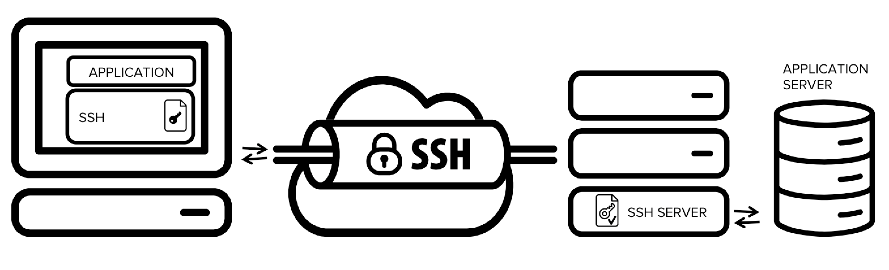
SSH TUNNEL
In computer terms, an SSH tunnel is a secure way to send information between two computers over the internet. It's like creating a private, encrypted connection, so even if someone tries to look at the information you're sending, they can't understand it
Using SSH tunnel we can access database from another computer.

Slide 6
In this lesson, we learned how to create a small website using Java Spring Boot and MySQL, and deploy the project on the PaaS (Platform as a Service) web service using Cloud Foundry.

